Slide 1
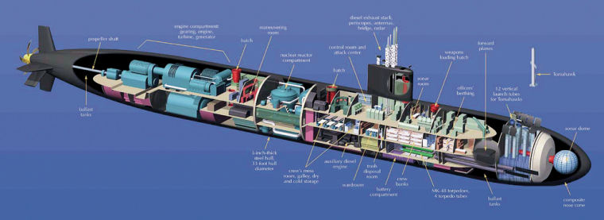
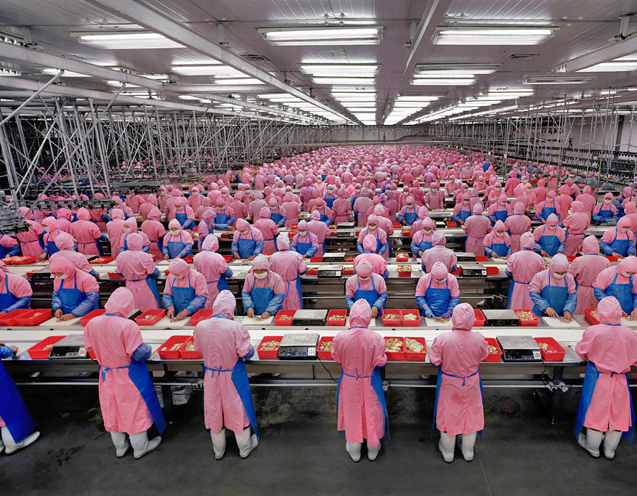

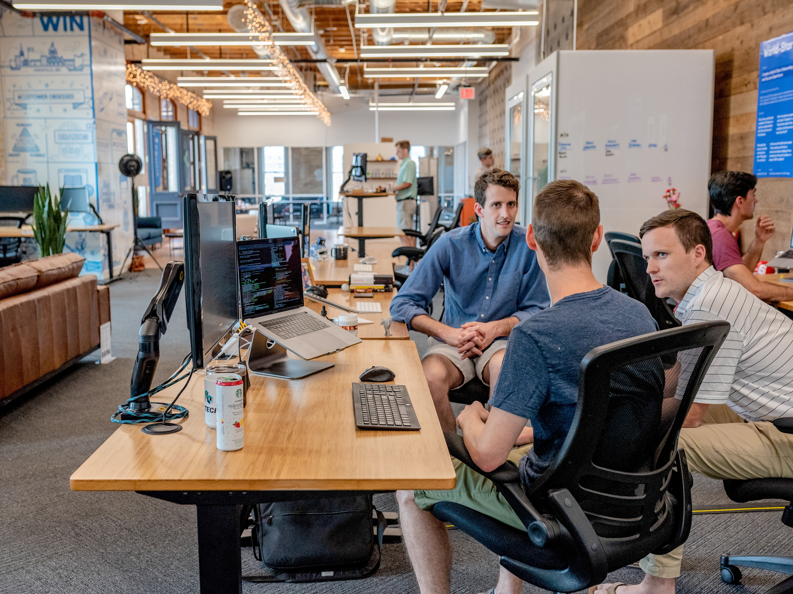
Turn The Ship Around!: A True Story of Turning Followers Into Leaders
”Leaders don’t create followers, they create more leaders.” – Tom Peters
GIVING CONTROL
TECHNICAL COMPETENCY
CLARITY
DEFINED LANGUAGES
DEFINED PROCESSES
DEFINED ROLES
Problem: LEADER-FOLLOWER
Solution: LEADER-LEADER
Take control
Give orders
When you give orders, be confident, unambiguous & resolution
Brief
Have meetings
Have a mentor-mentee program
Focus on technology
Think short-term
Want to be missed after you depart
Have high repetition, low quality training
Limit communication to terse, succinct formal orders
Be questioning
Make inefficient processes efficient
Increase Monitoring & Inspection Points
Protect Information
Give control
Avoid giving orders
When you give orders, leave room for questioning
Certify
Have conversations
Have a mentor-mentor program
Focus on people
Think long term
Want NOT to be missed after you depart
Have low repetition, high quality training
Augment orders with rich contextual informal communicators
Be curious
Eliminate entire steps & processes that don’t add value
Reduce monitoring & inspection points
Pass information
BOSS SAYS
WORKERS SAY
7. What have you BEEN DOING?
7. I’ve been doing …
6. What have you DONE?
6. I’ve DONE …
5. What do you INTEND to do?
5. I INTEND to …
4. What would you LIKE to do?
4. I would LIKE to …
3. What do you THINK?
3. I THINK …
2. What do you SEE?
2. I SEE …
1. I’ll TELL you what to do
1. TELL me what to do.
LeSS Principles
Cross-functionality
Continuous Improvement
Lean Thinking: avoid overburden
Whole-product focus
System thinking
Transparency
More with LeSS
Product Owner + Managers: Don’t micromanage, Let Go, Go See, Ask Team for help, Teach Higher Management; Provide Safe Environment for learning, decision-making by teams and taking risks
Scrum Master: actively Do Nothing, avoid Making Decisions for team, Decentralize, patience, openness, humility

Slide 2
CONTROL
TECHNICAL COMPETENCY
CLARITY
DEFINED LANGUAGES
DEFINED PROCESSES
DEFINED ROLES

Slide 4
BOSS SAYS
WORKERS SAY
7. What have you BEEN DOING?
7. I’ve been doing …
6. What have you DONE?
6. I’ve DONE …
5. What do you INTEND to do?
5. I INTEND to …
4. What would you LIKE to do?
4. I would LIKE to …
3. What do you THINK?
3. I THINK …
2. What do you SEE?
2. I SEE …
1. I’ll TELL you what to do
1. TELL me what to do.

Slide 5
BOSS SAYS
WORKERS SAY
7. What have you BEEN DOING?
7. I’ve been doing …
6. What have you DONE?
6. I’ve DONE …
5. What do you INTEND to do?
5. I INTEND to …
4. What would you LIKE to do?
4. I would LIKE to …
3. What do you THINK?
3. I THINK …
2. What do you SEE?
2. I SEE …
1. I’ll TELL you what to do
1. TELL me what to do.

